Slide 1
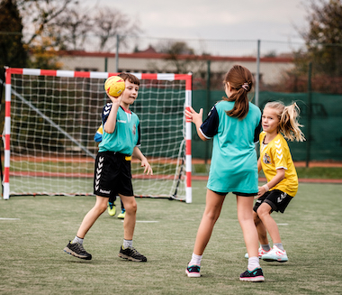
Handball Queensland
Lead-up Games for School Programs

Slide 2
Lead-Up Games
All activities presented below meet the following set of criteria:
they are easy to organize and play but competitive in nature,
require minimal equipment and set-up,
can be easily adapted to almost any circumstances,
provide learning and practicing opportunities for participants of various mastery levels,
combine physical and skill practicing moments,
stimulate continued participation and interest, and have added advantage of
resemble a number of key technical and tactical situations most often present during handball games.
Each lead-up game can be used as standalone activity or be part of a regular training session.
These games can be used to build a graduated, active warm-up routine
To facilitate their practical applications, all games include a short description of the main purpose, the equipment needed, diagrams of the set-up, variety notes and teaching tips.
They are not arranged in any order nor to meet any specific criterion as these depend on many variables and the lesson/unit objectives.
Each game can modified to suit your needs.
Enjoy, experiment, invent new versions & good luck in your daily practice!

Slide 3
Selected Lead-Up Games
 | Lead-up Game | Difficulty Level | Grade
1 | CONE HANDBALL | EASY | 7 - 10
2 | HULA-HOOP HANDBALL
3 | SIX PASSES HANDBALL | EASY | 7 - 10
4 | GATES HANDBALL | CHALLENGING | 7 -10
5 | HANDBALL IN ZONES | EASY | 7 -10
6 | ZONE HANDBALL | INTERMEDAITE | 7 - 10
7 | TOUCHDOWN HANDBALL | INTERMEDIATE | 7 - 10
8 | PROTECT YOUR ROYALS | INTERMEDIATE | 7 - 10
9 | PRISONERS & GURADS | EASY | 7 -10
10 | FEED THE TIGERS | EASY | 7 -10
11 | POLICE & THIEVES | EASY | 7 - 8
12 | BIG CHASE | EASY | 7 - 8

Slide 4
Character Counts
Respect the Rules
Respect the officials & accept their decisions
Respect your opponent
Give everybody an equal
chance to participate
Maintain your self-control
at all times!

Slide 5
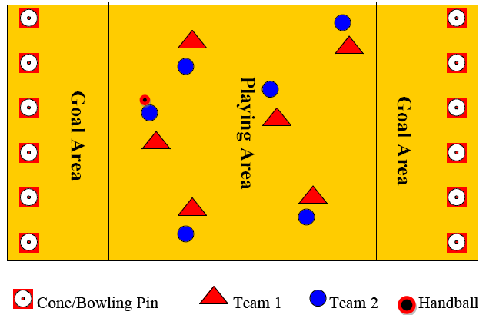
1. Cone Handball
Field Set-Up
Two teams of equal number of players compete to score as many points as they can within set time by knocking down cones/bowling pins placed in their opponents‘ goal areas.
All shots at the cones & defensive actions must take place outside the goal areas.
The game starts with a jump ball & is played according to no body contact rule.
Players can dribble, pass/catch, hold the ball for 3 sec. & make 3 steps with a ball.
A free-throw is a simple pass from one player to another to restart the game.
After each point scored, the game is restarted from the goal area by a captain.
If the ball goes out of bounds, the game is restarted from sideline with a throw-in.
A penalty shot is called when defender(s) fouls a shooter or protect cones in the goal area.
FOCUS:
passing/catching & throwing
individual offensive & defensive skills
EQUIPMENT:
1 handball, 6-12 cones/bowling pins, color pennies
COURT SIZE:
adapt to needs & availability

Slide 6
Cone Handball
VARIATIONS
TEACHING SUGGESTIONS
With time, increase difficulty by:
letting the players hold a ball for only one (1) second and/or
allowing only jump shots and/or
requiring set minimum of passes made before taking a shot and/or
replacing cones with smaller or different targets (i.e., bowling pins, medicine balls, a small hurdle/box/ serving as a goal) and/or
prohibiting dribbling, etc..
Full court individual defense (“man to man”) without switching should be used.
Rules should be simple to make fair and uncomplicated calls and can be modified according to participants’ preparedness and coach’s preferences.
Do not allow players to form any zone like defensive formations.
Encourage constant movement, short passes as well as simple “break-free from your guard” and “pass and go” offensive strategies.
Emphasize holding the elbow high (above the shoulder) and ball high above the head prior to passing and/or throwing.
Remind players often that passing is always faster than dribbling.
Challenge players to pass the ball to all teammates positioned in unguarded areas to receive the ball and not to just a few “friends”.
While in defense, stress the importance of keeping their bodies between the attacker and their own goal.

Slide 7
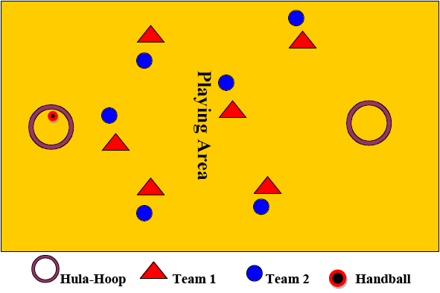
2. Hula-Hoop Handball
Field Set-Up
Two teams compete to score as many points as they can within set time by placing a ball inside 2-4 hula-hoops placed randomly on the floor/field.
The game starts with a jump ball & is played according to no body contact rule.
Players are allowed to dribble, pass/catch, hold the ball for 3 sec. & making 3 steps with a ball.
A free-throw is a simple pass from one player to another to restart the game.
A point is scored when the ball touches the ground inside a hula-hoop.
After each point scored, the game is restarted from that hula-hoop by a captain or another designated player.
If the ball goes out of bounds, the game is restarted from sideline with a throw-in.
FOCUS:
passing/catching & throwing
individual offensive & defensive skills
Improving cardiovascular endurance
EQUIPMENT:
1 handball, 2-4 hula-hoops, color pennies
COURT SIZE:
adapt to needs & availability

Slide 8
Hula-Hoop Handball
VARIATIONS
TEACHING SUGGESTIONS
When introducing the game for a first time, play it with only two (2) hula-hoops.
As players gain confidence in their individual skills, increase difficulty by adding 1-2 more hula-hoops. This will create an increased decision making, peripheral vision, and spatial orientation challenge for both offense and defense. In time, experiment with:
using various balls’ sizes and shapes,
letting the players hold a ball for only one (1) second and/or
allowing to use only “a weak” hand and/or
requiring set minimum of passes made before an attempt to score and/or
replacing hula-hoops with smaller targets such as one foot circular floor markers and/or
prohibiting dribbling, etc.
Full court individual defense (“man to man”) should be used.
Rules should be simple to make fair and uncomplicated calls and can be modified according to students’ preparedness and teacher’s preferences.
Do not allow players to form any zone like defensive formations around hula-hoops.
Encourage constant movement, short one hand overhead passes as well as simple “break-free from your guard” and “pass and go” offensive strategies.
Use verbal cues such as “Hold your elbow high!” and “Keep the ball above the head!” prior to passing to a partner.
Remind players that excessive dribbling slows down the game.
Challenge players to pass the ball to all teammates advantageously positioned in unguarded areas. Praise players for using situational passes (i.e., bounce pass) as the tactical circumstances may dictate.
While in defense, stress the importance of footwork (without crossing legs) and constant anticipation of the next pass to either intercept it or block it.
Stress positive encouragement, unselfish team play and active participation.

Slide 9
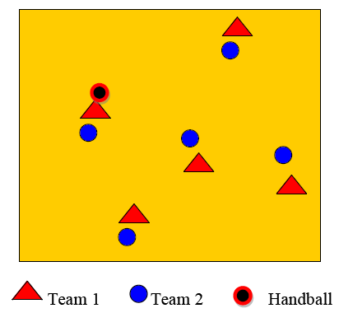
3. Six Passes Handball
FIELD SET-UP
Two teams compete to score as many points as they can within set time by attempting to make 6 consecutive passes among their teammates. Players must count out-loud number of passes being made.
The game starts with a jump ball & is played according to no body contact rule.
Players are allowed to dribble, pass/catch, hold the ball for 3 sec. & making 3 steps with a ball.
A free-throw is a simple pass from one player to another to restart the game.
A point is scored when the team completes 6 passes in a row without the ball being intercepted or lost due to technical error.
After each point scored, the game is restarted by a captain or another designated player from the other team.
If the ball goes out of bounds, the game is restarted from sideline with a throw-in. All passes made prior to a ball leaving the court are considered null and the team in possession of the ball needs to start their count from 0.
Each pass must be made between two different players.
FOCUS:
passing/catching & throwing
individual offensive & defensive skills
Improving spatial orientation
EQUIPMENT:
1 handball, color pennies
COURT SIZE:
adapt to needs & availability

Slide 10
Six Passes Handball
VARIATIONS
TEACHING SUGGESTIONS
With time, increase difficulty by:
letting the players hold a ball for only one (1) second and/or
prohibiting dribbling and/or
allowing only bounce and/or overhead pass etc.
Full court individual defense (“man to man”) without switching should be used.
Rules should be simple to make fair and uncomplicated calls and can be modified according to participants’ preparedness and coach’s preferences.
Encourage constant movement, short passes as well as simple “break-free from your guard” and “pass and go” offensive strategies.
Emphasize holding the elbow high (above the shoulder) and ball high above the head prior to passing and/or throwing.
Remind players often that passing is always faster than dribbling.
Challenge players to pass the ball to all teammates positioned in unguarded areas to receive the ball and not to just a few “friends”.
While in defense, stress the importance of keeping their bodies between the player with a ball and their own opponent.

Slide 11
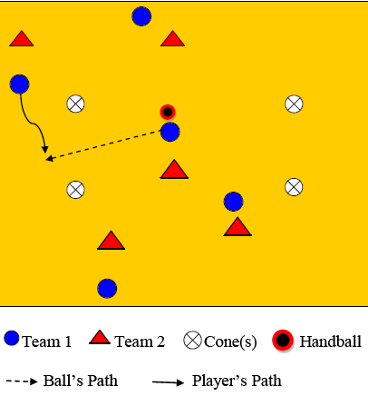
4. Gates Handball
FIELD SET-UP
Two teams compete to score as many points as they can within set time by either dribbling or passing the ball through 2-4 “gates” set up on the ground.
The game starts with a jump ball & is played according to no body contact rule.
Players are allowed to dribble, pass/catch, hold the ball for 3 sec. & making 3 steps with a ball.
A free-throw is a simple pass from one player to another to restart the game.
A point is scored when the team dribbles or passes the ball through any gate without the ball being intercepted or lost due to technical error. Players must count number of points being scored. No more than one goal can be scored on the same gate. No more than 1 pass can be made between the same 2 players in a row.
After each point scored, the game is restarted by a captain or another designated player from the other team any place on the court.
If the ball goes out of bounds, the game is restarted from sideline with a throw-in.
FOCUS:
passing/catching & throwing
individual offensive & defensive skills
Improving spatial orientation
EQUIPMENT:
1 handball, color pennies
COURT SIZE:
adapt to needs & availability

Slide 12
Gates Handball
VARIATIONS
TEACHING SUGGESTIONS
With time, increase difficulty by:
adding more “gates”(up to 4)
decreasing the width of gates
allowing the team in possession of the ball to score multiple points until turnover is committed
letting the players hold a ball for only one (1) second and/or
prohibiting dribbling and/or
allowing only bounce and/or overhead passes etc.
Full court individual defense (“man to man”) without switching should be used but as players master the former it is advisable to introduce “switches”.
Rules can be modified according to participants’ preparedness and coach’s preferences.
Encourage constant movement, short passes as well as simple “break-free from your guard” and “pass and go” offensive strategies.
Emphasize holding the elbow high (above the shoulder) and ball high above the head prior to passing and/or throwing.
Remind players often that passing is always faster than dribbling.
Challenge players to keep their heads up and look for teammates positioned in unguarded areas.
While in defense, stress the importance of keeping their bodies between the player with a ball and their own opponent.
When playing with 3 or 4 “gates”, consecutive points must not be scored on the same “gate” two times in a row.

Slide 13
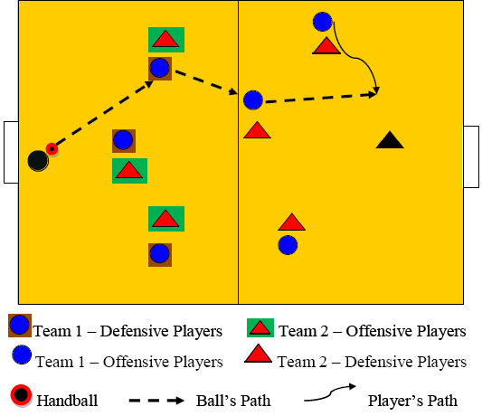
5. Handball in Zones
FIELD SET-UP
Two teams compete to score as many points as they can within set time by throwing a ball into their opponent’s goal.
Within each team, players are divided into attackers and defenders.
The game starts with a jump ball & is played according to no body contact rule.
Players are allowed only one-hand passing and 2-hand catching & holding the ball for 3 seconds.
A free-throw is a simple pass from one player to another to restart the game.
After each point scored, the game is restarted by a goalkeeper.
If the ball goes out of bounds, the game is restarted from sideline with a throw-in.
Half-way through the game, during the game goalkeepers, attackers and defenders should rotate through all three positions
FOCUS:
passing/catching & throwing
spatial orientation
understanding of defense & offense concept
EQUIPMENT:
1 handball, 1-2 hockey goals or cones or gymnastic mats, one scooter per player, color pennies
COURT SIZE:
adapt to needs & availability

Slide 14
Scooter Handball in Zones
VARIATIONS
TEACHING SUGGESTIONS
With time, change and/or increase difficulty by:
letting players hold a ball for only one (1) second and/or
passing only forward and/or
requiring to make 4-5 passes before attempting to score and/or
requiring a pass to female athlete if teams are co-ed before attempting to score and/or
“lifting” zone restrictions (introducing concept of crease/goal area), etc.
Rules should be simple to make fair and uncomplicated calls and can be modified according to participants’ preparedness and coach’s preferences.
Encourage short and safe passes.
Emphasize holding the elbow high (above the shoulder) and ball high above the head prior to passing and/or throwing.
Challenge players to pass the ball to all teammates positioned in unguarded areas to receive the ball and not to just a few “friends”.
While in defense, stress the importance of keeping their bodies between the player with a ball and their own opponent and using their hands to block shots and/or intercept passes.
Discuss the importance of wide spacing and team work in advancing the ball from the goal area forward.

Slide 15
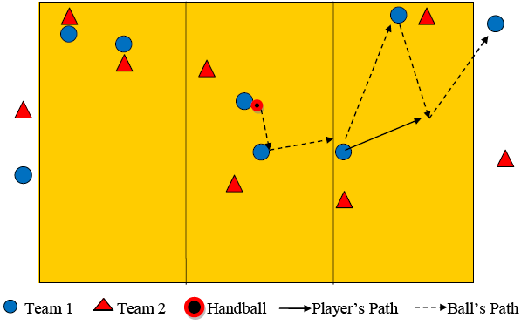
6. Zone Handball
FIELD SET-UP
Two teams compete to score as many points as they can within set time by advancing the ball from zone to zone & throwing/passing it to their captains standing in the end zone(s).
Within each team, players are divided into groups of 2 or 3 players each and assigned one zone to play in.
The game starts with a jump ball & is played according to no body contact rule.
Players are allowed to dribble, pass & catch, hold the ball for 3 seconds & make 3 steps with the ball. Before advancing the ball, players must make at least 2 passes within their own respective zone.
A free-throw is a simple pass from one player to another to restart the game.
A point is awarded for each successful pass to either of the captains standing in the goal areas. After each point scored, the game is restarted in the central zone with a jump-ball.
If the ball goes out of bounds, the game is restarted from sideline with a throw-in.
During the game players should be rotated between all three zones.
FOCUS:
passing/catching, dribbling & throwing
spatial orientation
individual defense (marking) & offense (getting free and available for a pass)
EQUIPMENT:
1 handball, cones, color pennies
COURT SIZE:
adapt to needs & availability

Slide 16
Zone Handball
VARIATIONS
TEACHING SUGGESTIONS
With time, change/increase difficulty by:
letting the players hold a ball for only one (1) second and/or
allowing only a bounce pass to score and/or
requiring more than 2 passes to be made before moving the ball up and/or
prohibiting dribbling and/or
restarting the game after each point scored from the end zone instead of the center zone and/or
increasing size of the field, etc.
Later on, consider either limiting number of zones to two (2) or “lifting” zones restrictions altogether. Once the zones’ restriction lift is in effect, the game can be continued with captains standing in the adult size or mini-handball goal areas or their various versions such gymnastic mats, large hula-hoops, basketball’s 3-point areas, basketball’s key areas, or any other available clearly identified spots.
Within each zone, players should use individual defense (“man to man”) without and/or with switching depending on their level of readiness.
Rules should be simple to make fair and uncomplicated calls and can be modified according to participants’ preparedness and coach’s preferences.
Encourage constant movement, short passes as well as simple “break-free from your guard” and “pass and go” offensive strategies.
Emphasize holding the elbow high (above the shoulder) and ball high above the head prior to passing and/or throwing.
• Challenge players to be creative in solving 2 vs. 2 (3 vs. 3) situations within their respective zones.
While in defense, stress the importance of keeping their bodies between the attacker and their own goal and positioning in the passing lines to increase chances of intercepting the ball.
Rotate players between zones, change captains, assign additional conditioning tasks to be done by players in zones farthest from the “action”

Slide 17
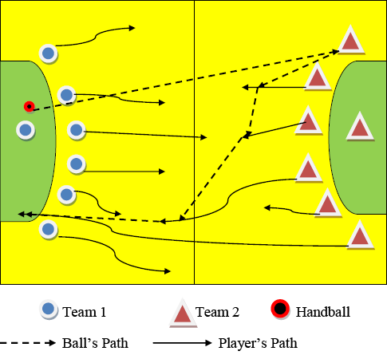
7. Touchdown Handball
FIELD SET-UP
Two teams compete to score as many points as they can within set time by advancing the ball up the court and throwing/passing it to their teammates open in the end zone.
The game starts with a throw-off by a goalkeeper standing in the goal area and all players assuming 6:0 formations around their goal area. Once the ball is released into the air, players are free to assume any position they see fit.
The game is played according to no body contact rule or according to adapted rules.
Players are allowed to dribble, pass & catch, hold the ball for 3 seconds & make 3 steps with the ball.
The receiving team tries to score by passing a ball to any open teammate inside their opponent’s goal area. After each touchdown, the scoring team wins a right to try for a bonus point. To earn it, a goalkeeper throws the ball directly from his goal area into an opposite goal.
After each drive, the game is restarted by another throw-off from a goalkeeper to the opposing team.
A free-throw is a simple pass from one player to another to restart the game.
If the ball goes out of bounds, the game is restarted from sideline with a throw-in.
FOCUS:
passing/catching, dribbling & throwing
spatial orientation, endurance
individual defense (marking) & offense (getting free and available for a pass)
EQUIPMENT:
1 handball, cones, color pennies
COURT SIZE:
adapt to needs & availability

Slide 18
Touchdown Handball
VARIATIONS
TEACHING SUGGESTIONS
With time, increase difficulty by:
letting the players hold a ball for only one (1) second and/or
allowing only forward passing and/or
limiting dribbling to 2-3 bounces or prohibiting it altogether and/or
requiring set number of passes made before scoring and/or
implementing defensive two-hand touch either forcing a pass within three seconds or a turn-over and/or
designate up to three (3) exclusive receivers per team, etc.
Full court or half court individual defense (“man to man”) without or with switching should be used.
Rules can be modified according to participants’ preparedness and coach’s preferences.
Do not allow players to form any zone like defensive formations.
Encourage constant movement, quick and short passes as well as simple “break-free from your guard” and “pass and go” offensive strategies.
Accent importance of “bridging” or advancing the ball by short and accurate lateral passes in direct contact with opponents.
Discourage crossing patterns, long passes, and jump passes.
Remind players often that passing is always faster than dribbling.
Challenge players to pass the ball to teammates positioned in unguarded and less defense dense areas.
While in defense, stress the importance of keeping their bodies between the attacker and their own goal, importance of correct footwork, tactical fouls to stop the attack, etc.

Slide 19
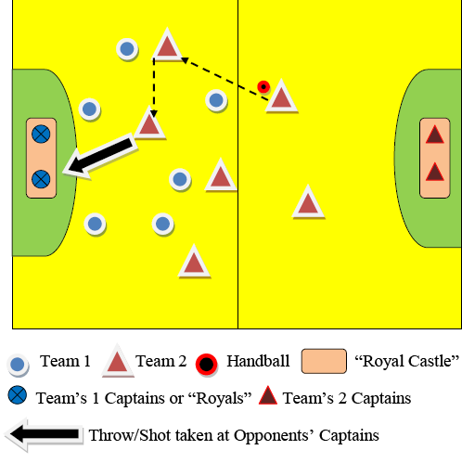
8. Protect Your Royals
FIELD SET-UP
Two teams compete to score as many points as they can within set time by advancing the ball up the court and throwing it at their opponents’ two captains standing inside a goal area within clearly marked smaller area called “Royal Castle”.
The game starts with a jump-ball and is played according to no body contact rule or according to adapted rules.
Players are allowed to dribble, pass & catch, hold the ball for 3 seconds & make 3 steps with the ball.
Both captains can move freely inside the “Royal Castle” and dodge the shots fired at them by attackers.
All shots should be made with one hand, preferably using an overhand technique. A point is scored when either 1 or both captains are hit with a ball below head level.
After each hit, the game is restarted by the team’s non-hit captain. If both are hit by the same shot, the attacking team earns 2 points & either captain restarts the game. If the captain gets hit but manages to catch the ball, no pints are awarded & game continues on.
A free-throw is a simple pass from one player to another to restart the game.
If the ball goes out of bounds, the game is restarted from sideline with a throw-in. If the ball goes past the end-line, either captain can run out, bring it back, and pass it to his teammates to begin another offensive action.
FOCUS:
passing/catching ,dribbling & throwing
concept of goal area, spatial orientation
individual defense (marking, blocking) & offense (getting free, available for a pass, attacking gaps, setting picks)
EQUIPMENT:
1 handball, cones, color pennies
COURT SIZE:
adapt to needs & availability

Slide 20
Protect Your Royals
VARIATIONS
TEACHING SUGGESTIONS
With time, change/increase difficulty by:
making the “Royal Castle” smaller and/or
decreasing number of defenders per team and/or
prohibiting dribbling and/or
allowing for only jump shots or set shots and/or
limiting number passes or time prior to shooting at the target and/or
letting the players hold a ball for only one (1) second and/or
decreasing number of captains from 2 to 1, etc.
Half court individual defense (“man to man”) or zone defense can be used.
Rules can be modified according to participants’ preparedness and coach’s preferences.
Challenge offensive players to use “piston” movement and attack the gaps.
Encourage creativity (simple crosses between 2 players, pick and roll, screens, overload) in producing shooting opportunities.
Emphasize holding the elbow high (above the shoulder) and ball high above the head prior to passing and/or throwing.
Remind players often that passing is always faster than dribbling.
While in defense, stress the importance of keeping their bodies between the attacker and their own goalkeeper (captain), protecting their goalkeepers (captains) by continuous shifting, checking, blocking, challenging passing lines, intercepting long passes, etc.

Slide 21
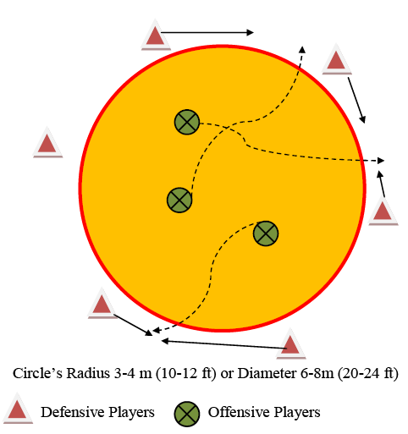
9. Prisoners & Guards
FIELD SET-UP
Two teams compete to score as many points as they can within set time by breaking through each other defensive zone formation(s).
The game starts with one team positioned around circular playing area and facing inward while half of the other team is standing inside the circle facing outward. The other half awaits its turn and supports participating teammates. Such set-up creates 6 vs. 3 starting situation.
On signal, players who were inside the circle (prisoners) try to run outside through gaps between defensive players while defensive players (guards) shuffle/shift sideways and try to close the existing gaps. If two neighboring defensive players shift fast enough to touch each other hands, offensive players must back up and try again. They can’t dive low, slide into the floor, jump over defenders’ hands or use body contact to force entry or to barge through.
Once first group of players gets outside the circle, the second groups comes in and attempts to escape in similar manner by using variety of faking techniques and tactical strategies.
Offensive players can ask for one time only 30 seconds time out to briefly discuss group actions.
The game continues until all players escape or by set time. The team with the higher number of escapees wins the game.
FOCUS:
footwork, shifting, closing gaps
concept of zone
offensive fakes
EQUIPMENT:
enough cones to mark field, color pennies
COURT SIZE:
see above or adapt to needs & availability

Slide 22
Prisoners & Guards
VARIATIONS
TEACHING SUGGESTIONS
With time, change/increase difficulty by:
increasing circle’s radius which in turn will increase the length of circles perimeter and/or
decreasing number of defenders and/or
requiring offensive players to escape from the circle while dribble the ball, etc.
Encourage players to take a time-out and discuss possible tactical solutions.
Remind offensive players to experiment with variety of techniques, strategies and use rapid direction, tempo, rhythm, pattern changes to increase their chances.
Challenge players to pass the ball to all teammates positioned in unguarded areas to receive the ball and not to just a few “friends”.
While in defense, stress the importance of proper footwork, cooperation with adjacent defenders, and verbal/visual communication between teammates.

Slide 23
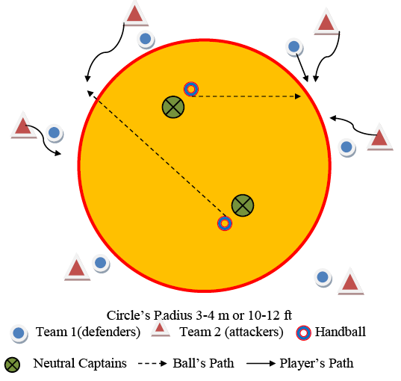
10. Feed the Tigers
FIELD SET-UP
Two teams of equal numbers of participants (5-7) with 2 neutral captains compete to score points by passing (“feeding”) a ball to players guarded closely by defenders who attempt to intercept those passes and/or deny a pass to reach a recipient.
The game starts with both teams positioned around circular playing area. Offensive players face inward while defensive players face outward. Such set-up creates 6 vs. 6 “man to man” starting situation. Two neutral captains stand inside the circle facing outward, each with 1 handball.
On signal, offensive players (“tigers”) try to break free from their respective defenders and receive a pass from one the two neutral captains. If they catch a pass, they switch place with captain who “fed” them. Defensive players mark their opponents and try to deny a good pass and/or intercept the ball. If they make a “steal”, they switch with captain responsible for a bed pass.
Both captains can freely move within the circle to find open offensive players.
The game continues until all participants play at least once as a captain or by set time. Offense receives one point for each successful catch while defense receives 1 point for each interception.
If the ball becomes loose and bounces back or rolls back into the circle, no points are awarded. All participants must remain outside the circle at all times.
The game can be played according to no body contact rule or official handball rules based on players’ readiness and coach’s plans.
FOCUS:
footwork, shifting, closing gaps
concept of zone
offensive skills: fakes, passing/catching
EQUIPMENT:
enough cones to mark field, color pennies, 2 soft-skinned handballs
COURT SIZE:
see above or adapt to needs & availability

Slide 24
Feed the Tigers
VARIATIONS
TEACHING SUGGESTIONS
With time, change/increase difficulty by:
requiring neutral captains to dribble their handballs prior to making a pass to offensive players and/or
increasing number of captains from 2 to 3 or 4 and/or
increase/decrease size of the circle and/or number of players per team and/or
allow for a feed with a bounce pass and/or
limiting offensive players’ space to break free and receive the pass from circle’s full perimeter to half, quarter, and finally 1/6th for 6 vs. 6 situations, etc.
Also, this lead-up game can be used to practice “pivot” marking in two most common situations when defender assumes position either in front or directly behind the offensive player (“pivot”). In such case, both pivot and defensive player will face inward and see two neutral captains face to face.
Individual defense (“man to man”) without switching should be primarily used but switching opponents can be introduced as soon as players are ready and can handle it.
While in defense, stress the importance of keeping their bodies between the attacker and neutral captains operating inside the circle area. Defenders should keep an eye on both their opponents & neutral captains holding the ball. They need constantly reassess their position & change it continuously to remain not only in control but also to put offensive players in disadvantageous situations. Their main objectives are to deny the pass and possibly intercept the ball by correctly reading and anticipating the pass’ path.
While in offence, encourage constant movement, quick position changes, simple fakes without the ball to break free from guards, using other players’ motions to gain body position advantage that could be enough to catch the pass.
Remind neutral captains of using their peripheral vision to “scan the horizon” for more than one available receivers. Emphasize the importance of timing and variety of passes that make defending challenging or easier.
When practicing guarding pivots, have players practice both scenarios: in front and behind the pivot. Make them be aware of their pivot’s physical attributes as well as technical/tactical strong and weak sides that can be exploited in defense (i.e., left/right-handed, tall/short, fast/slow, can turn both sides/always turn right, feels tempo/usually late to react).
When practicing positional play as pivots, allow players to experiment in finding their own solutions to very unique and often rapidly changing situations that are associated in playing this position. Stress significance of observing the field of play, “fighting” for a body advantage, catching passes with one and two hands, etc.

Slide 25
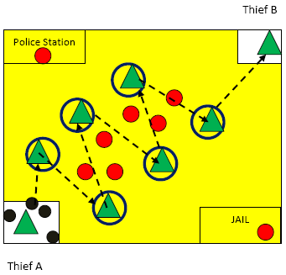
11. Police and Thieves
FIELD SET-UP
Two teams of equal numbers of players compete. Offensive team scores points by passing handballs from Thief A to B. Defensive teams scores points by stealing/intercepting balls passed by attackers & tagging them if they run out of their hula-hoops.
The game starts with all handballs being with Thief A and attackers positioned on their flat markers. Defenders take any place except next to the first and last attackers. They can’t block first or last pass.
On signal, Thief A passes a ball to the first attacker in line and they (“thieves”) try to get their handballs from A to B while defenders attempt to steal those and take them to the Police Station.
Defenders can tag attackers who run out of their hula-hoops to retrieve a ball due to a bad pass or catch. Tagged attackers must go to “Jail” and stay there until rescued by either Thief A or B who need to run to “Jail” and “High5” all prisoners.
The game continues until all handballs get transported by attackers to Thief B or all handballs get stolen by defenders and transported to “Police Station”. Then, teams switch roles.
The game can be contested also within set time.
FOCUS:
passing/catching
teamwork, agility, speed
intercepting, blocking
EQUIPMENT:
cones, 1 hula-hoops per passing player, color pennies, 6-8 handballs, 4 mats
COURT SIZE:
see above or adapt to needs & availability

Slide 26
Police & Thieves
VARIATIONS
TEACHING SUGGESTIONS
With time, change and/or increase difficulty by:
increasing distances between attackers and/or
allowing defenders to challenge first pass (from Thief A), last pass(to Thief B)or both passes and/or
allowing defenders to use only 1 hand or no hands and/or
using various balls (size, weight, shape)
requiring attackers to pass with weak hand.
While in defense, stress the importance of keeping their bodies in the passing lanes. They need constantly reassess their position & change it continuously to remain not only in control but also to put offensive players in disadvantageous situations. Their main objectives are to deny the pass and possibly intercept the ball by correctly reading and anticipating the pass’ path.
While in offence, encourage passing fakes and situational passes.
Emphasize importance of teamwork and support.
Make sure that defenders do not double on one attacker and stay at least 3 feet from any attacker.
Attackers can be tagged only if they are out of the hula-hoop with both feet.
Rotate Thieves A and B as well attackers through their hula-hoops.

Slide 27
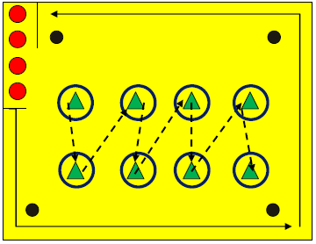
12. Big Chase
FIELD SET-UP
Two teams of equal numbers of participants (5-7) with 2 neutral captains compete to score points by passing (“feeding”) a ball to players guarded closely by defenders who attempt to intercept those passes and/or deny a pass to reach a recipient.
The game starts with both teams positioned around circular playing area. Offensive players face inward while defensive players face outward. Such set-up creates 6 vs. 6 “man to man” starting situation. Two neutral captains stand inside the circle facing outward, each with 1 handball.
On signal, offensive players (“tigers”) try to break free from their respective defenders and receive a pass from one of the two neutral captains. If they catch a pass, they switch place with captain who “fed” them. Defensive players mark their opponents and try to deny a good pass and/or intercept the ball. If they make a “steal”, they switch with captain responsible for a bed pass.
Both captains can freely move within the circle to find open offensive players.
The game continues until all participants play at least once as a captain or by set time. Offense receives one point for each successful catch while defense receives 1 point for each interception.
If the ball becomes loose and bounces back or rolls back into the circle, no points are awarded. All participants must remain outside the circle at all times.
The game can be played according to no body contact rule or official handball rules based on players’ readiness and coach’s plans.
FOCUS:
running, dribbling, passing & catching
teamwork
footwork, speed, agility
EQUIPMENT:
enough cones to mark field, color pennies, 2 soft-skinned handballs
COURT SIZE:
see above or adapt to needs & availability

Slide 28
Big Chase
VARIATIONS
TEACHING SUGGESTIONS
With time, change and/or increase difficulty by:
changing the distance to run and/or
increasing distance between offensive players passing the ball and/or
increasing the number of required passes to be made and/or
changing task fro defending team from dribbling to running backwards, side-stepping, slaloming, rolling the ball and/or
While in defense, stress the importance of and control correct technique of required tasks (i.e., dribbling without looking down, switching hands when dribbling between cones, not crossing legs when side-stepping).
While in offence, remind players to keep correct passing mechanics. Emphasize the importance of focus and ready position in delivering a good pass as well as catching the ball.
Encourage teamwork and verbal support for each other.
Once in a while, rotate attackers through hula-hoops so that they pass and receive the ball from different partner.

